Slide 1

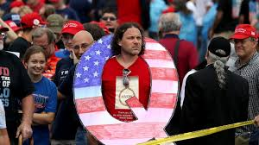
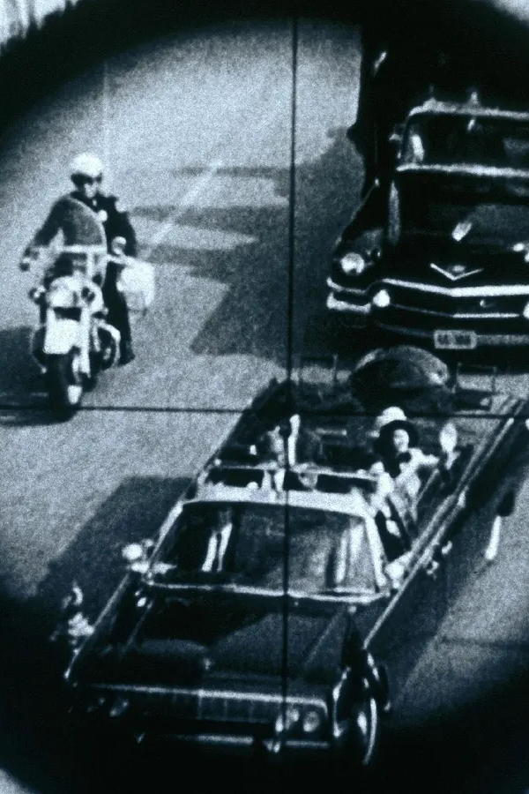

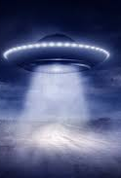
Conspiracy theories
What are they, why are they so popular, and why are they dangerous?

Slide 2
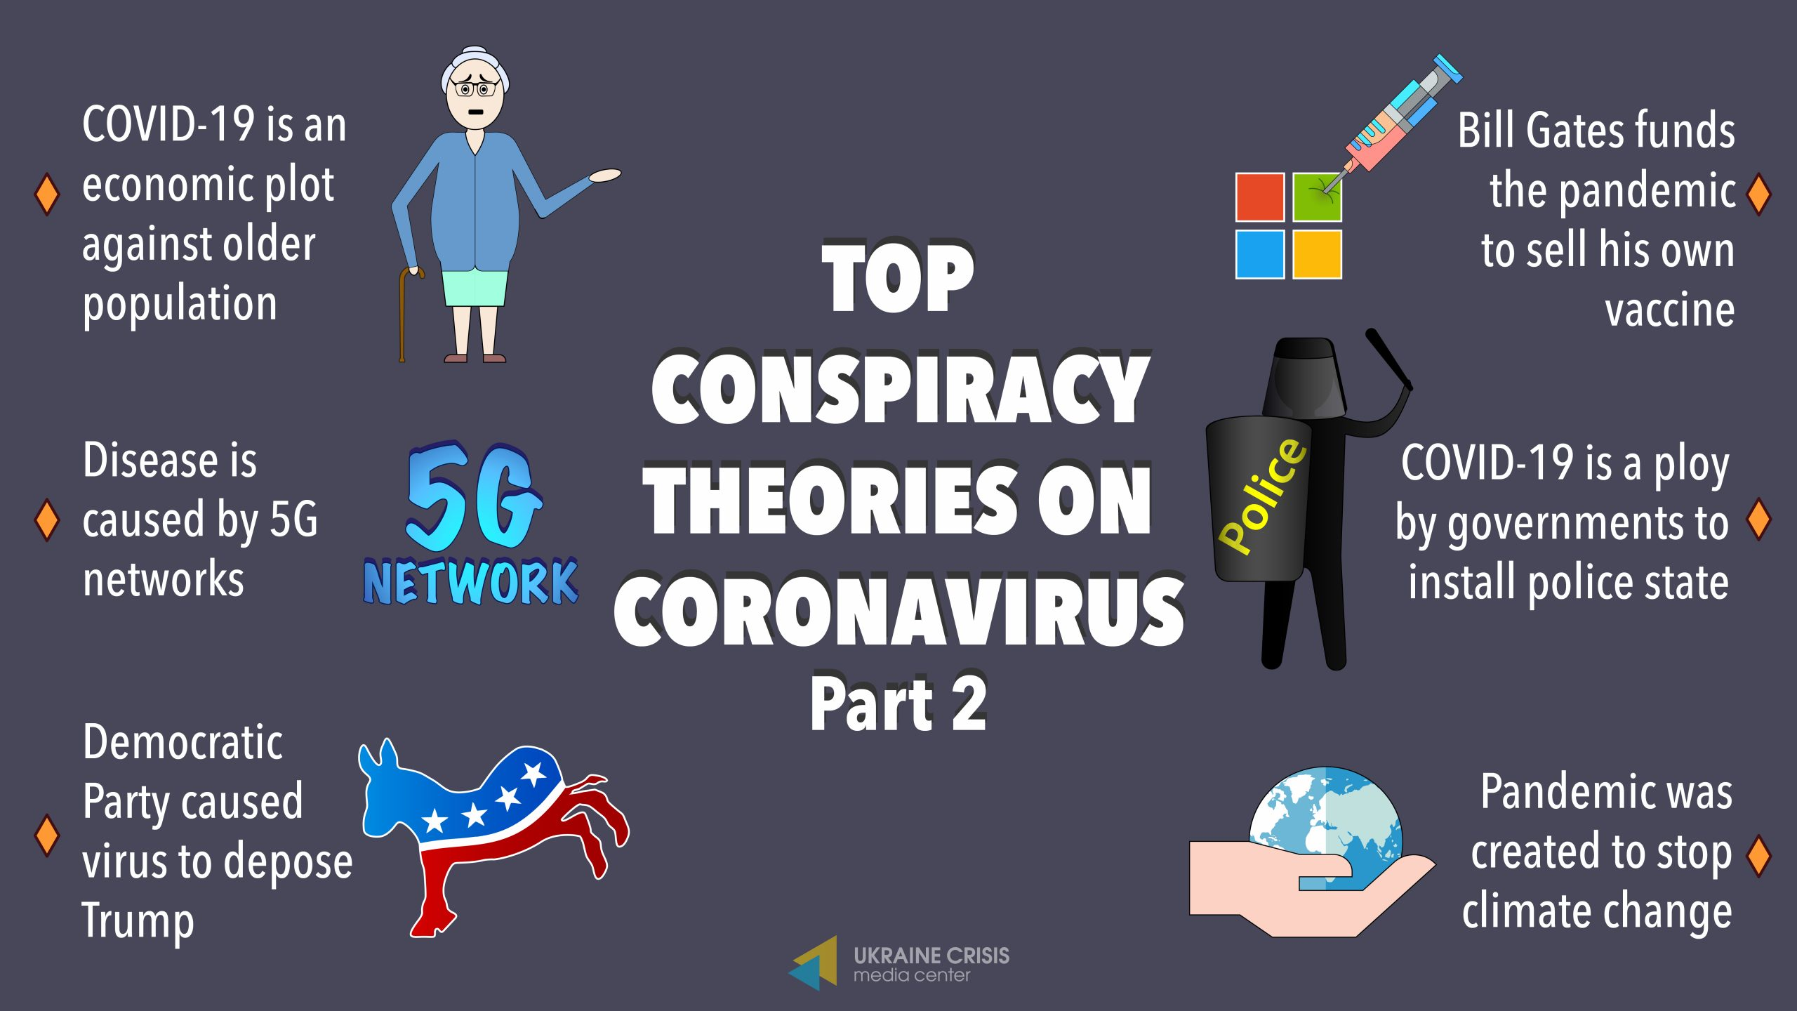
Conspiracy theories are all around us on the news and in social media. They can range from silly gossip about people to harmful misinformation about governments.
They are explanations for events or situation that put the blame on a conspiracy by powerful and sinister groups rather than taking the generally accepted evidence as true.
What conspiracy theories have you heard about? Which ones do you think seem plausible?

Slide 3
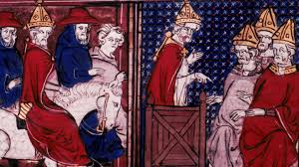
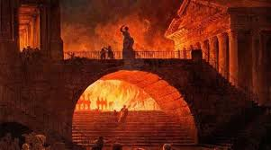
It is often suggested that ‘fake news’ and conspiracy theories are products of the modern age and new media.
Yet while modern technology has meant that all information, including conspiracy theories, can spread far faster than ever before, the idea of conspiracy theories is as long as history itself.
The Crusades started with Pope Urban II in 1095 spreading rumours that Christian were being tortured in Jerusalem (in fact referring to events around a century before, while even earlier after the fire of Rome in 64AD is said to have been blamed by many Romans on the suspicious new religious sect of Christians.

Slide 4
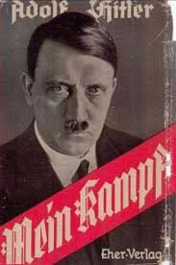
A very dangerous conspiracy theory with tragic real life consequences for the 20th century came from ‘The Protocols of the Elders of Zion
This was a book written in Russia to try and attack the Jewish community there and claim that there was a global Jewish conspiracy to bring down western governments. This ended up being believed by many or even most people in Europe, and was a crucial part of Hitler’s anti-semitic beliefs (given some explanation here) and then policies in his rise to power and his rule over Nazi Germany, eventually leading to the devastation and tragedy of the Holocaust with the death of 7 million Jews.
For all that they are an obvious and clear work of fiction they are still referred to by many people as genuine, including a reference to them in Dan Brown’s ‘The Da Vinci Code’ which says it the start that the story is ‘grounded in fact’. (For a comprehensive deconstruction of this story you can see: https://www.youtube.com/watch?v=Z_tarLRdO3k)

Slide 5
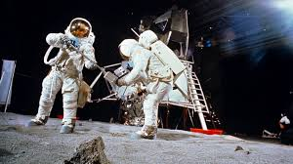
Why do people believe conspiracy theories?
Often when you look at the evidence or ideas underpinning them conspiracy theories can seem totally ridiculous as shown by this brilliant clip by Mitchell and Webb about the conspiracy that the moon landings were faked by the American Government.
The idea that all the hundreds of thousands of NASA employees involved in the project would all have kept the secret that the moon landing was fake is clearly ludicrous (along with the spurious ‘evidence’ to support the claim) and yet one in six people in Britain believe this conspiracy theory as shown in this recent article.

Slide 6

The circular argument
The circular argument of conspiracy theories tends to be ‘There is a flaw in your argument therefore all of your argument is wrong. My argument is right so if there are flaws in it they do not matter.’
In the case of the moon landing conspiracy theorists come up with endless reasons why they think the moon landing did not happen and just need one element of that argument to make sense to them for their argument to be true.
In contrast someone arguing against them can have as much evidence on their side as they like and their argument will still be rejected as they are just part of the big government cover up!

Slide 7
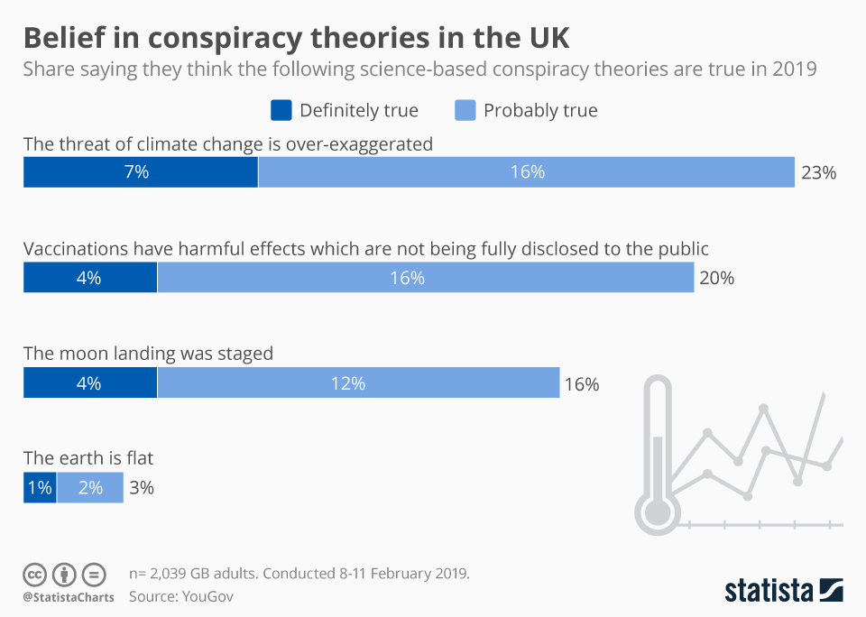
Here are a number of different reasons why conspiracy theories hold such a powerful sway with so many people

Slide 8
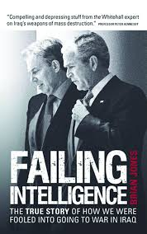
1 – Sometimes there is a conspiracy
One of the key things that gives life to conspiracy theories is that sometimes there is a conspiracy! As was once written, ‘just because you’re paranoid it does not mean everybody isn’t out to get you.’
A very well known recent example of this is the use of faulty intelligence to justify the invasion of Iraq to depose Saddam Hussain in 2003. A dossier of evidence was presented by the British government claiming that Saddam had weapons of mass destruction and so needed to be deposed. What it did not admit was that most of it had been copied (including typing errors) from a graduate student in California rather than coming from government intelligence sources. You can see in this speech by Tony Blair after the war (3 minutes in) that he accepts that there were issues with the decision to go to war.
A rather ironic clip here too shows Donald Trump criticising the decision to go to war in Iraq saying that President Bush who made that decision should be impeached.

Slide 9
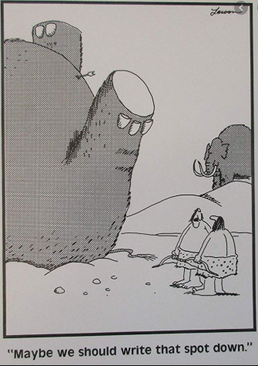
2 – The Primitive Mind
Homo Sapiens has been around for 200,000 years or so and we have been living in modern urban societies for around 200 years. In many ways our brains are not evolved to cope with the society we find ourselves in and is more attuned to the African savannah where physical threats from rival humans or other animals were a daily reality.
In those surroundings it is an advantage to be looking out for unseen threats so psychologists have suggested that natural selection has favoured the conspiratorial mindset.

Slide 10
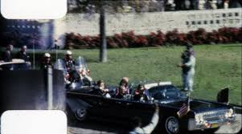
3 Proportionality bias
Our brains have other cognitive biases that make us susceptible to conspiracy theories. One is proportionality bias, a belief that major events have major causes.
Perhaps the best example of this is the assassination of American President Kennedy (often known as JFK) in November 1963. All reasonable evidence points to Lee Harvey Oswald as a disturbed lone assassin but it has become the centre of a conspiracy theory industry in books and documentaries.

Slide 11
The killing of this glamorous young president (only 46) shook the nation, and it could be that argued that people simply could not bring themselves to believe that he had been killed just because of a lone madman. Modern media tends to popularise conspiracy theories, and this is certainly the case with this theory which has had many films made about it.
One of the most famous is JFK. In it a legal case to try and prove that there were other gunmen seems to have brilliant evidence to prove this.
Watch this clip about a ‘magic bullet’ . It seems to disprove Oswald as a lone gunman as showing that his single could not have caused all the injuries.
Are you convinced watching this?

Slide 12
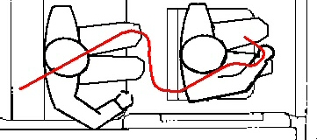
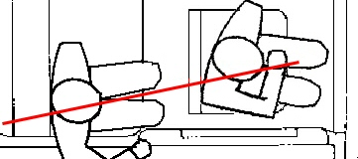
There is of course a simple explanation!
The magic bullet theory uses the first drawing, but when the relative positions of Kennedy and the man in front of him are accurate the trajectory of the bullet is clear!
Magic bullet Non-magic bullet!
This very selective and distorted use of evidence is typical of conspiracy theory arguments
Do you think films like JFK that repeat conspiracy theories are a big concern?

Slide 13
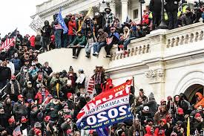
4 Intentionality and Confirmation bias
These two cognitive biases tend to make us assume that events are planned by somebody or something (intentionality) and tend to make us seek out evidence that agrees with our view (confirmation)
Both of these biases can be seen very clearly in the most recent conspiracy theory – that the Democrat party cheated and ‘stole’ the Presidential election from Donald Trump. While these claims can be very easily disproved as shown by this clip
The attack on the capitol by Trump supporters on 6th January 2021 on this basis shows clearly the serious real-life consequences of these conspiracy theories.

Slide 14
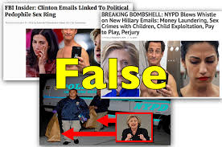
5 Personality types and ‘click baiting’
There is also clearly a personality type that is more receptive to conspiracy theories with people who are naturally suspicious of received wisdom and authority more likely to believe them.
Where modern technology has done a lot to spread conspiracy theories is in appealing to people like this – ‘click baiting’. Social media companies make money from advertising and so by getting people to click on stories that make them angry or upset, often conspiracy theories, they make more money.
In 2016 Donald Trump’s conspiracy theories about Hilary Clinton were spread by social media sites. Many of these came from North Macedonia from a group of people who did not care about the election but wanted to make money from advertising! You can see the story here.

Slide 15
6 Emotional reassurance
Conspiracy theories can also be emotionally reassuring. They provide truthful-sounding explanations for events that otherwise seem inexplicable, and often make your political opponents look bad.
They can also give believers a pleasing sense of superiority because they – and sometimes they alone – have seen through the lies and cover-ups to reveal the “truth”.
This is the case with many believers of Q-Anon. This is a slightly longer clip that explains the attraction of this conspiracy theory so perhaps one to look at after the lesson: https://www.youtube.com/watch?v=ZusqgWUNFG4

Slide 16
What do you think is the best way to combat conspiracy theories?
For a longer listen on this topic try the following podcast:
https://open.spotify.com/episode/3BTOEpn16IpTEVfcW6sl25?si=M23qh4WDRVCTCNTEcJBe5g

